Slide 1
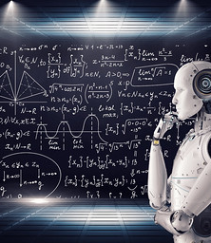
Deep Learning with Python Recurrent Neural Network (RNN)
Edgar Lobaton, Ph.D.
Electrical & Computer Engr. Dept.
North Carolina State University

Slide 2
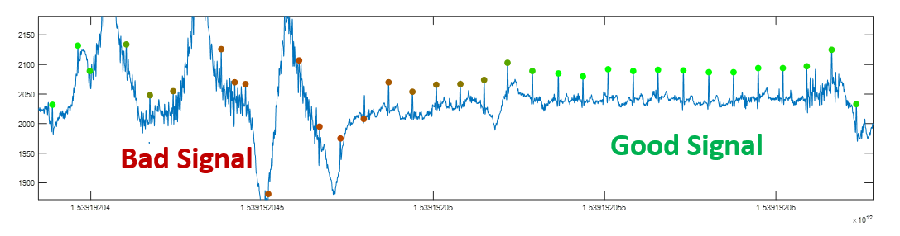
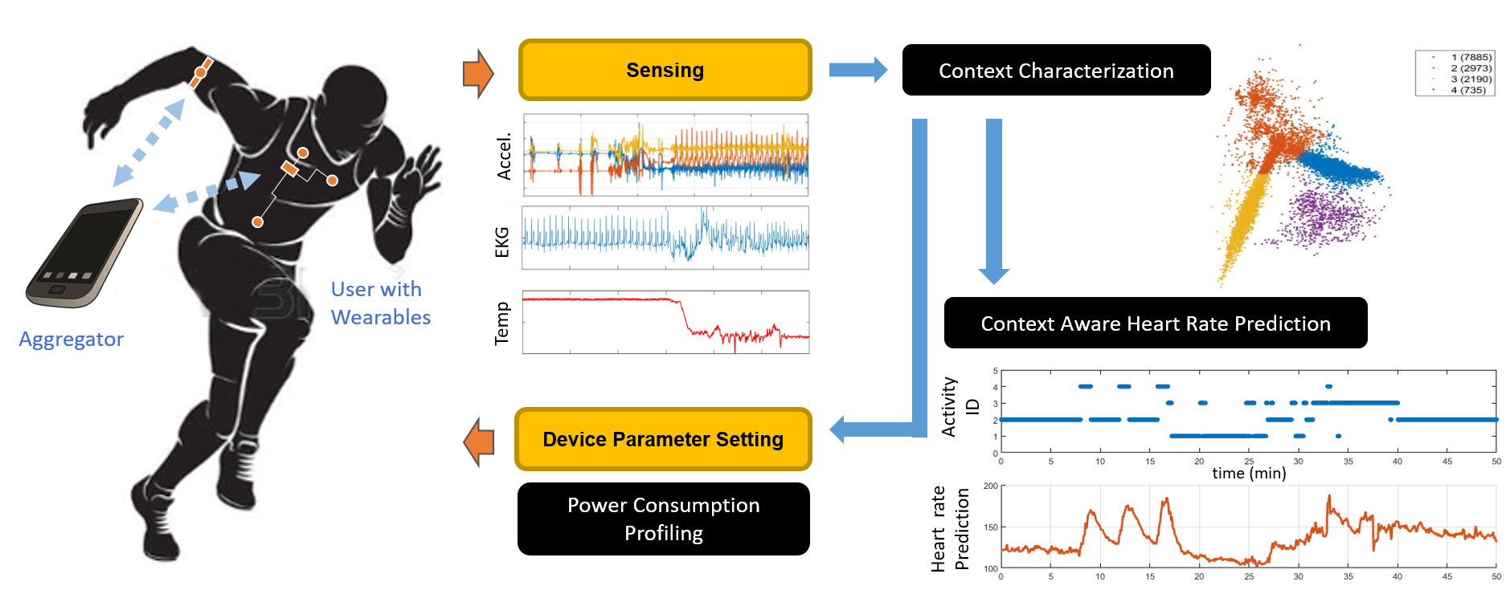
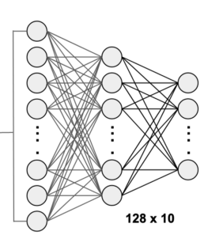
Sequential Data
We need something more specialized for time-series data (e.g., NLP, stock market, physiological responses, video sequences)
FCNs and CNNs are an alternative. However, they do not exploit potential temporal information. They are memoryless.
EKG Signal
Activity Recognition
Heart Rate Prediction
Prediction

Slide 3
Recurring Neural Networks (RNNs)
Basic equations:
$$h^{\left(t\right)}=g\left(W_{h}h^{\left(t−1\right)}+W_{x}x^{\left(t\right)}+b\right)$$
$$y^{\left(t\right)}=Vh^{\left(t\right)}+c$$
The network can be unrolled:
$$y$$
Output
$$h$$
Output
$$y^{\left(t−2\right)}$$
$$y^{\left(t−1\right)}$$
$$y^{\left(t\right)}$$
$$y^{\left(t+1\right)}$$
$$x$$
Input
$$h^{\left(t−2\right)}$$
$$h^{\left(t−1\right)}$$
$$h^{\left(t\right)}$$
$$h^{\left(t+1\right)}$$
$$x^{\left(t−2\right)}$$
$$x^{\left(t−1\right)}$$
$$x^{\left(t\right)}$$
$$x^{\left(t+1\right)}$$
Input

Slide 4
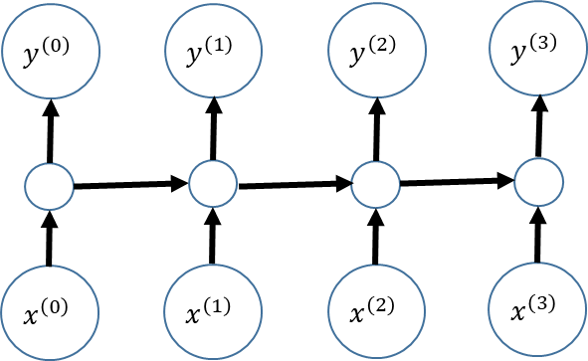
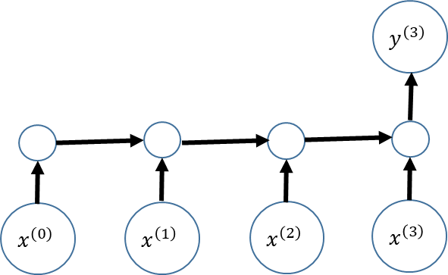
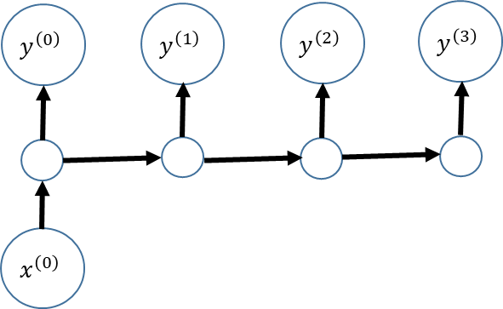
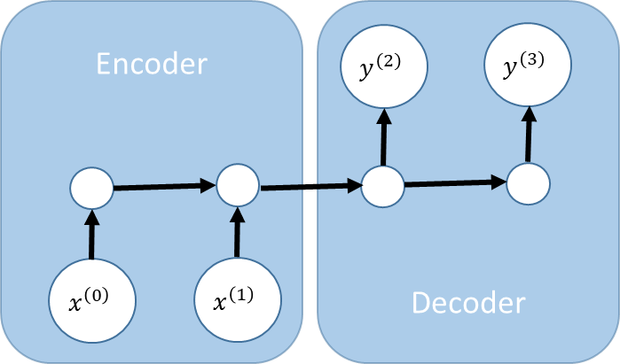
Sample Variants of RNNs
Predicting stock prices or physiological response
[Many to Many]
Sentiment score of a movie review [Many to One]
Sentence translation [Encoder-Decoder]
Caption generation for an image [One to Many]

Slide 5

Training RNNs
Loss function $L\left(\left\{{\hat{y}}^{\left(1\right)},…, {\hat{y}}^{\left(τ\right)}\right\},\left\{y^{\left(1\right)},…, y^{\left(τ\right)}\right\}\right)=\sum_{t=1}^{τ}{L\left({\hat{y}}^{\left(t\right)},y^{\left(t\right)}\right)}$
For training for a sequence, we unroll the network through time with shared parameters and use regular backpropagation.
This strategy is referred to as Backpropagation Through Time (BPTT).
Output
$$y^{\left(t−2\right)}$$
$$y^{\left(t−1\right)}$$
$$y^{\left(t\right)}$$
$$y^{\left(t+1\right)}$$
$$h^{\left(t−2\right)}$$
$$h^{\left(t−1\right)}$$
$$h^{\left(t\right)}$$
$$h^{\left(t+1\right)}$$
$$x^{\left(t−2\right)}$$
$$x^{\left(t−1\right)}$$
$$x^{\left(t\right)}$$
$$x^{\left(t+1\right)}$$
Input

Slide 6
Long Short-Term Memory (LSTM)
$$y^{\left(t\right)}$$
$$c^{\left(t−1\right)}$$
Forget Gate
$$c^{\left(t\right)}$$
Sigmoid
X
+
Tanh
Input Gate
X
X
$$h^{\left(t\right)}$$
$c^{\left(t\right)}$ serves as a state
$h^{\left(t\right)}$ tracks the output
The forget gate determines when to reset the state
The input gate determines what information to integrate with the state
The output gate specifies what to output
$$f^{(t)}$$
$$g^{(t)}$$
$$i^{(t)}$$
$$o^{(t)}$$
Output Gate
FC
FC
FC
FC
$$h^{\left(t−1\right)}$$
$$x^{\left(t\right)}$$

Slide 7
Long Short-Term Memory (LSTM)
$$y^{\left(t\right)}$$
$$c^{\left(t−1\right)}$$
Forget Gate
$$c^{\left(t\right)}$$
Sigmoid
X
+
Tanh
Input Gate
X
X
$$h^{\left(t\right)}$$
$$f^{(t)}$$
$$g^{(t)}$$
$$i^{(t)}$$
$$o^{(t)}$$
$$g^{\left(t\right)}=\tanh\left(W_{xg}⋅x^{\left(t\right)}+W_{hg}⋅h^{\left(t−1\right)}+b_{g}\right)$$
$$i^{\left(t\right)}=σ\left(W_{xi}⋅x^{\left(t\right)}+W_{hi}⋅h^{\left(t−1\right)}+b_{i}\right)$$
$$f^{\left(t\right)}=σ\left(W_{xf}⋅x^{\left(t\right)}+W_{hf}⋅h^{\left(t−1\right)}+b_{f}\right)$$
$$o^{\left(t\right)}=σ\left(W_{xo}⋅x^{\left(t\right)}+W_{ho}⋅h^{\left(t−1\right)}+b_{o}\right)$$
$$c^{\left(t\right)}=f^{\left(t\right)}⊙{ c}^{\left(t−1\right)}+i^{\left(t\right)}⊙{ g}^{\left(t\right)}$$
$$y^{\left(t\right)}=h^{\left(t\right)}=o^{\left(t\right)}⊙tanh⁡(c^{\left(t\right)})$$
Output Gate
FC
FC
FC
FC
$$h^{\left(t−1\right)}$$
$$x^{\left(t\right)}$$

Slide 8




Thank you
Edgar Lobaton
edgar.lobaton@ncsu.edu
https://research.ece.ncsu.edu/aros/

